Slide 1

Planned Maintenance Pillar
Awareness Training Programme

Slide 2
Planned Maintenance
(Keikaku Hozen)

Slide 3
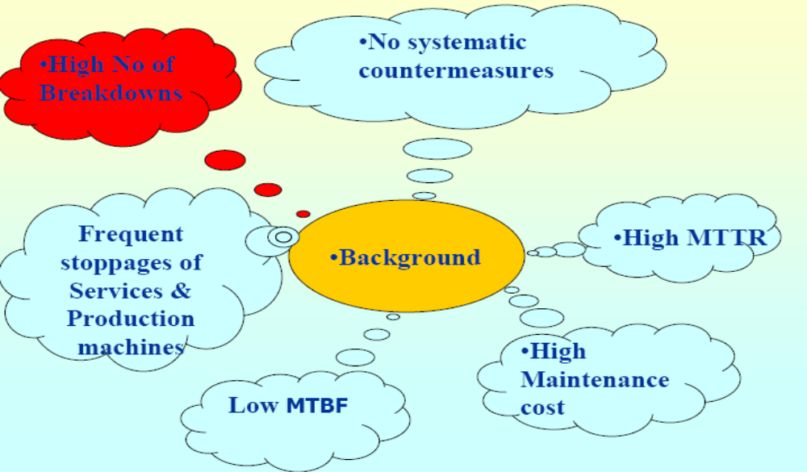
Background - Planned Maintenance

Slide 4
Aim - Planned Maintenance
To ensure the reliability and maintainability of equipment at reduced maintenance cost.

Slide 5
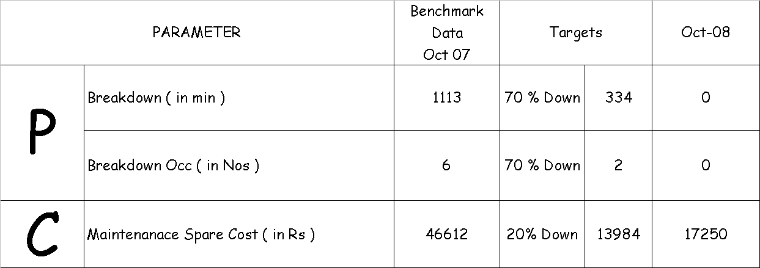
Target - Planned Maintenance

Slide 6
Planned Maintenance
APPROACH :
1.Maintenance activities
To prevent failures
To fix failures
2.Improvement activities
-To extend life span of parts
To shorten maintenance time
- To avoid maintenance

Slide 7
Types of Maintenance
Maintenance activities to prevent / fix failures
  Preventive Maintenance
    Time based maintenance
      Daily checks, Periodic checks, Periodic servicing
    Condition based maintenance
      Rotating equipment diagnostic
      Static equipment diagnostic
  Breakdown Maintenance
Improvement activities to expand life span / to shorten maintenance time / to avoid maintenance
  Corrective maintenance
  Maintenance prevention

Slide 8
PREVENTIVE MEDICINE FOR EQUIPMENT
= PREVENTIVE MAINTENANCE
PREVENTIVE MEDICINE
DAILY
PREVENTION
HEALTH
CHECKUPS
EARLY
TREATMENT
DAILY MAINT.
(Clean, Lubricate,
adjust,Inspect)
INSPECTION
(Diagnosis)
MAKE PREVENTIVE
REPAIRS
(Advance Replacements)
PREVENTIVE MAINTENANCE

Slide 9
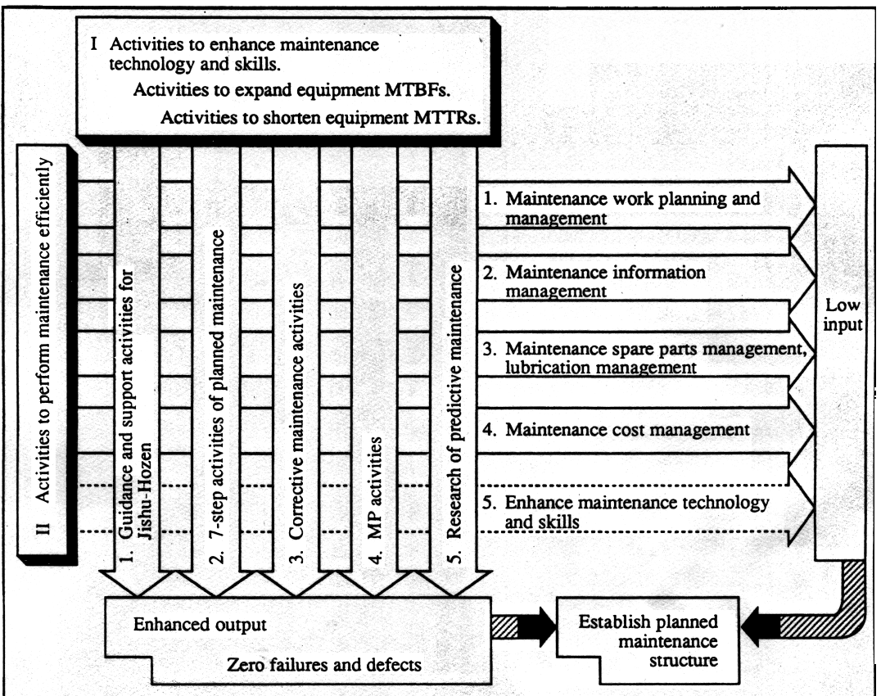
Planned Maintenance Activities

Slide 10
PM - 7 Step Methodology
Step-1 : Support & guidance of JH activity.
Step-2 : Evaluation of equipment failure / breakdown status & understand the current situation.
Step-3 : Reverse Deterioration & correct weakness
Step-4 : Build an information management system
Step –5 : Build a periodic maintenance system.
Step-6 : Build a Predictive maintenance system
.
Step-7 : Evaluate the Planned maintenance system.

Slide 11
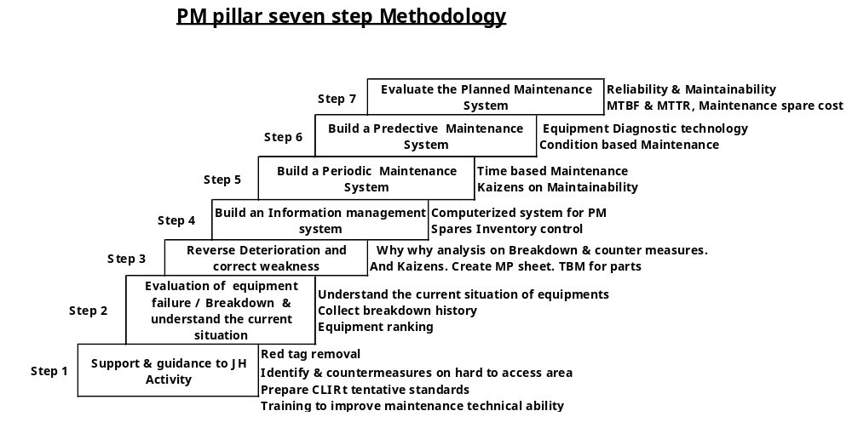
7 Step Methodology

Slide 12
Step-1 –Support & Guidance of JH Activity
Educate operators regarding structure of equipment, mechanism and how to find abnormalities by cleaning and inspection.
Red tag removal which requires technical solutions.
Prepare red tag summary
Countermeasures against sources, hard to access areas.
Assistance in preparing tentative standards.
Education and on the job training in JH step-4.

Slide 13
Step-1 –Support & Guidance of JH Activity
Training to Operator’s :
Basic Functioning of Metalizing Machine
EXHAUST
AIR
TRANSFORMER
MAIN
VALVE
EVAPORATION
CHAMBER
DIFFUSION
PUMP
ROUGH
VALVE
FRL
UNIT
DRIVE
MOTOR
PRESSURE
SWITCH
HEATER
BACK
VALVE
BOOSTER
PUMP
MAIN
ELECTRICAL
PANEL
PC
CONTROL
PANEL
OIL
FILTER
WATER
ROTARY
PUMP

Slide 14
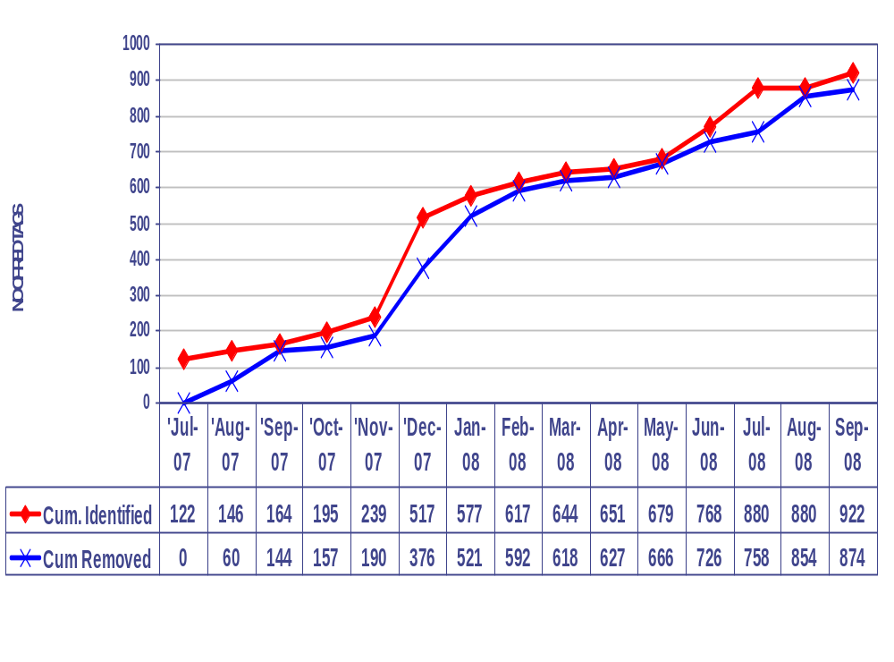
Step-1 –Support & Guidance of JH Activity
Red Tag Removal :

Slide 15
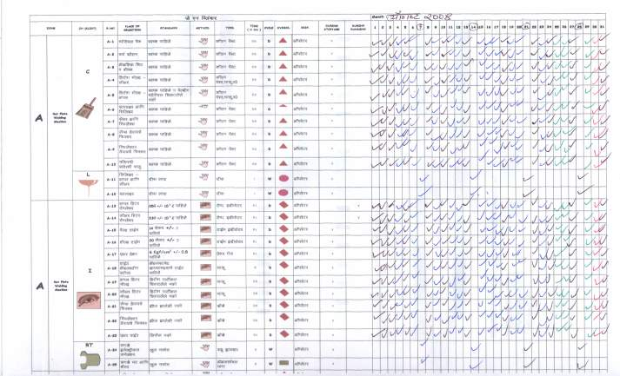
Step-1 –Support & Guidance of JH Activity
CLIRT Tentative standard preparation :
Similar Tentative standards are prepared for all equipments

Slide 16
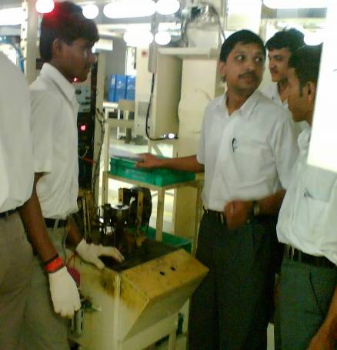
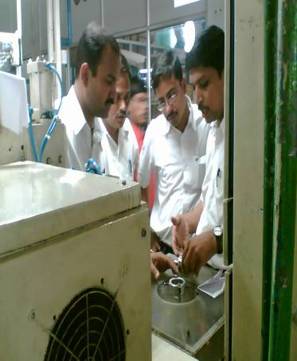
Step-1 –Support & Guidance of JH Activity
Training to Machine operators & supervisors for breakdown due to weak JH

Slide 17
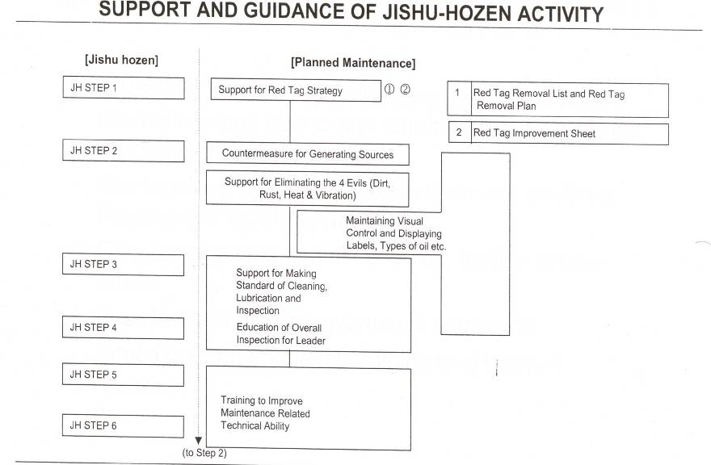
Step-1 –Support & Guidance of JH Activity

Slide 18
Step-2 – Evaluation of equipment failure / breakdown status & understand current situation
Understand the current situation of equipments.
Collect data (past breakdown history) of all failures / breakdowns
Prepare Equipment control ledger
Decide what are the equipments to be taken for PM activities using evaluation of equipment ranking criteria.
Understand the nature of loss and equipment importance, set target for equipment failure / breakdown.

Slide 19
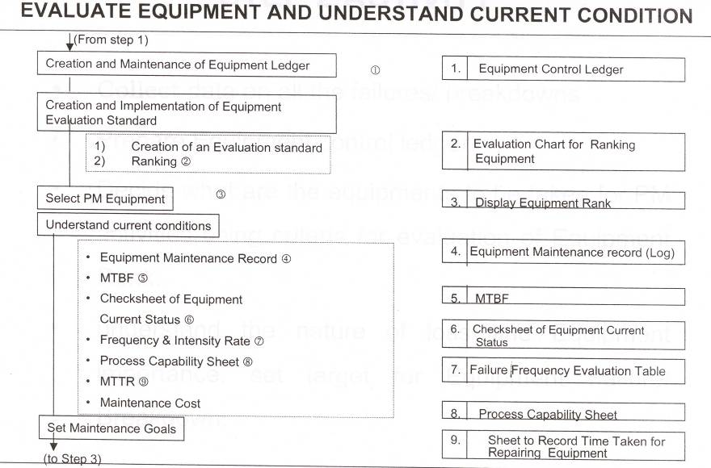
Step-2 – Evaluation of equipment failure / breakdown status & understand current situation

Slide 20
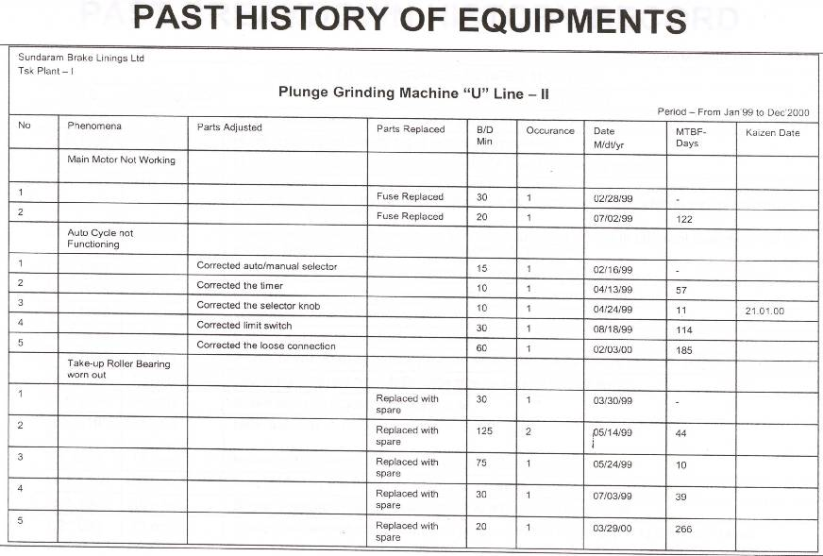
Step-2 – Evaluation of equipment failure / breakdown status & understand current situation

Slide 21
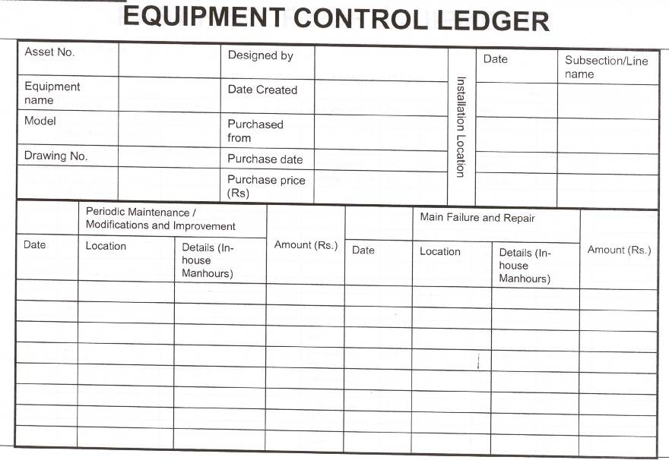
Step-2 – Evaluation of equipment failure / breakdown status & understand current situation

Slide 22
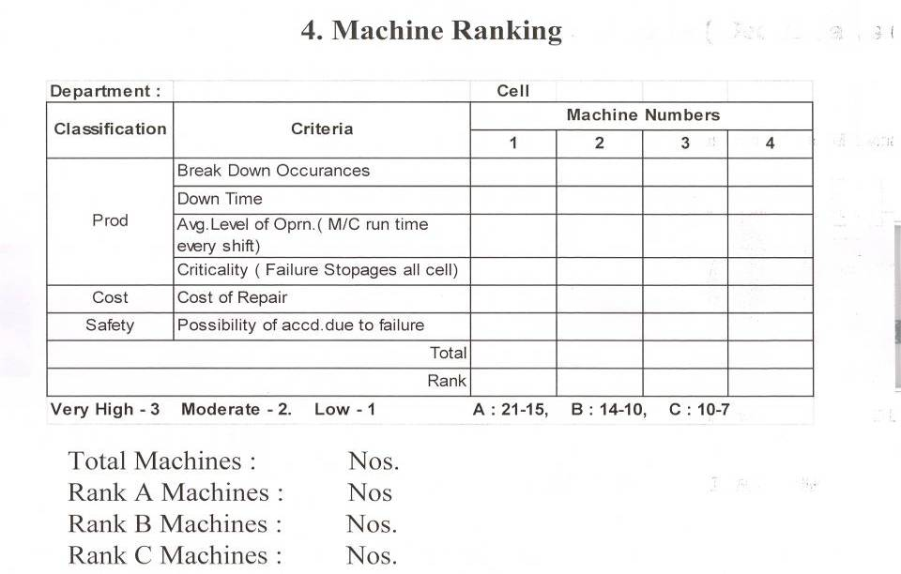
Step-2 – Evaluation of equipment failure / breakdown status & understand current situation

Slide 23
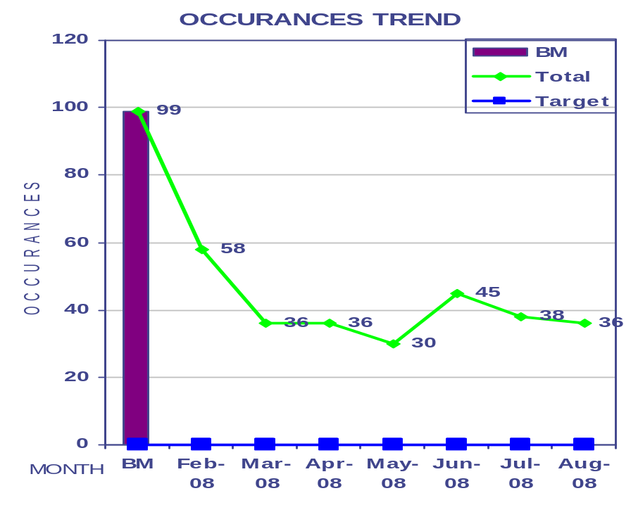
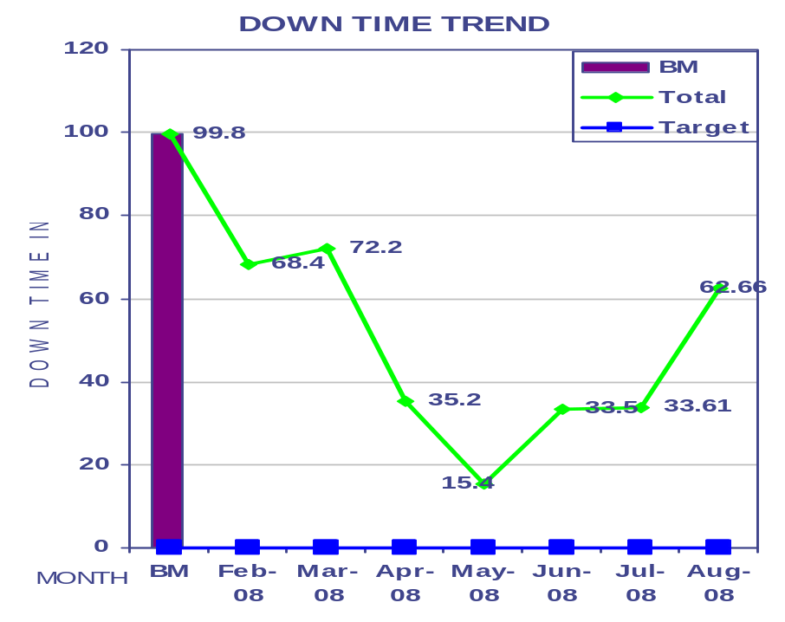
Step-2 – Evaluation of equipment failure / breakdown status & understand current situation
JAN ~ JUL 07
JAN ~ JUL 07
OCC – GroupWise
Down Time - GroupWise
GROUP | BM | APR | MAY | JUN | JUL | AUG
TOTAL | 99 | 36 | 30 | 45 | 38 | 36
SM | 51 | 24 | 25 | 35 | 24 | 17
FWM | 35 | 7 | 4 | 7 | 13 | 12
WIPER | 13 | 5 | 1 | 3 | 01 | 07
GROUP | BM | APR | MAY | JUN 08 | JUL | AUG
TOTAL | 99.8 | 35.2 | 15.4 | 33.5 | 33.61 | 62.66
SM | 41.5 | 11.4 | 9.3 | 28.0 | 21.25 | 43
FWM | 46.9 | 6.8 | 5.7 | 3.7 | 11.61 | 8.08
WIPER | 11.4 | 17.0 | 0.5 | 1.8 | 0.75 | 11.58

Slide 24
Step-3 – Reverse Deterioration & correct weakness
Restoration of deterioration by inspection using optimal condition check sheet
JH activities of operation division should be technically supported.
Defects, deterioration and weak points of design to be found out; Why Why analysis and countermeasure are to be implemented.
Improvements are to be made to strengthen the weak points of design.
Create MP Sheet
Maintenance skill in the above should be improved.

Slide 25
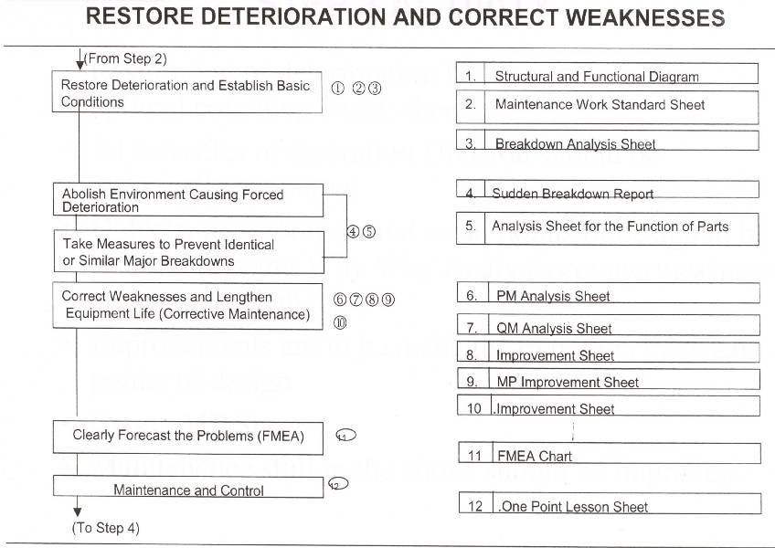
Step-3 – Reverse Deterioration & correct weakness

Slide 26
Role of Maintenance during Step-3
Abolish the environment causing forced deterioration with the help of operation division
Using Breakdown analysis sheet of each equipment, find the breakdown whether natural or forced.
If the breakdown is natural and analysis finding is weak design, improve the design by Kaizen.
Follow TBM and CBM for vital and essential parts of Equipment.

Slide 27
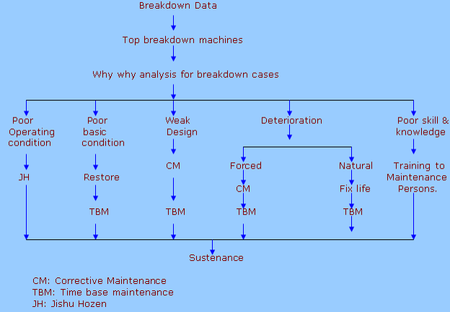
Step-3 – Reverse Deterioration & correct weakness

Slide 28
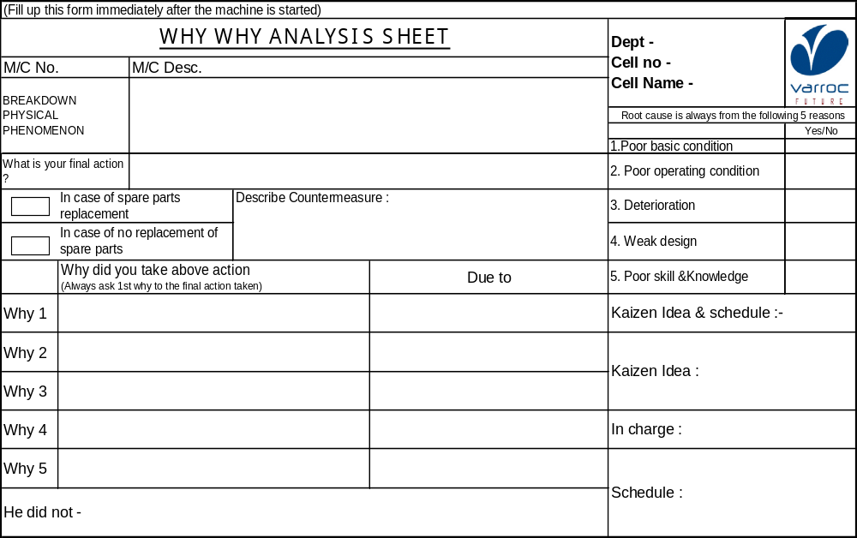
PM WHY WHY ANALYSIS SHEET

Slide 29
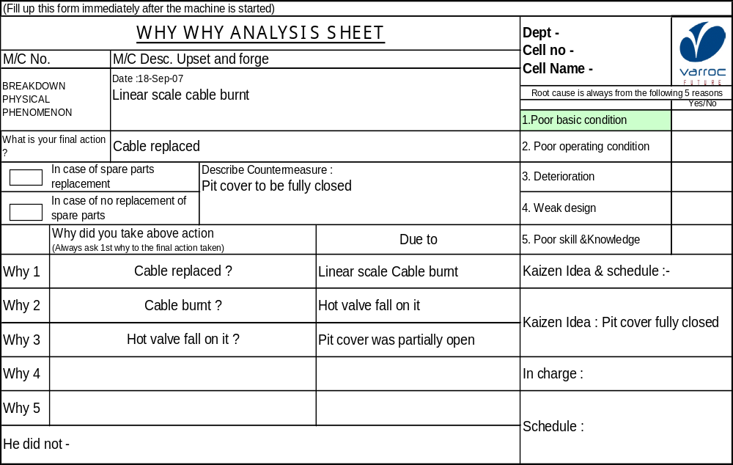
PM WHY WHY ANALYSIS SHEET
Poor basic condition

Slide 30
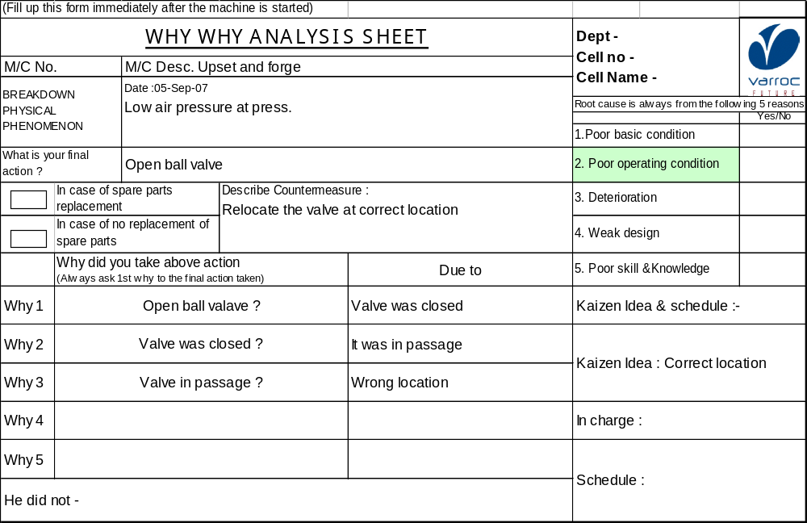
PM WHY WHY ANALYSIS SHEET
Poor operating condition

Slide 31
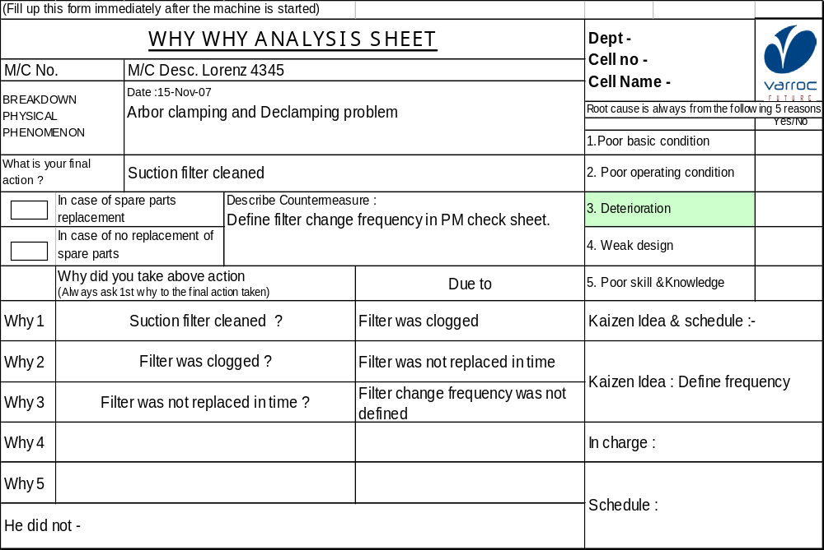
PM WHY WHY ANALYSIS SHEET
Deterioration

Slide 32
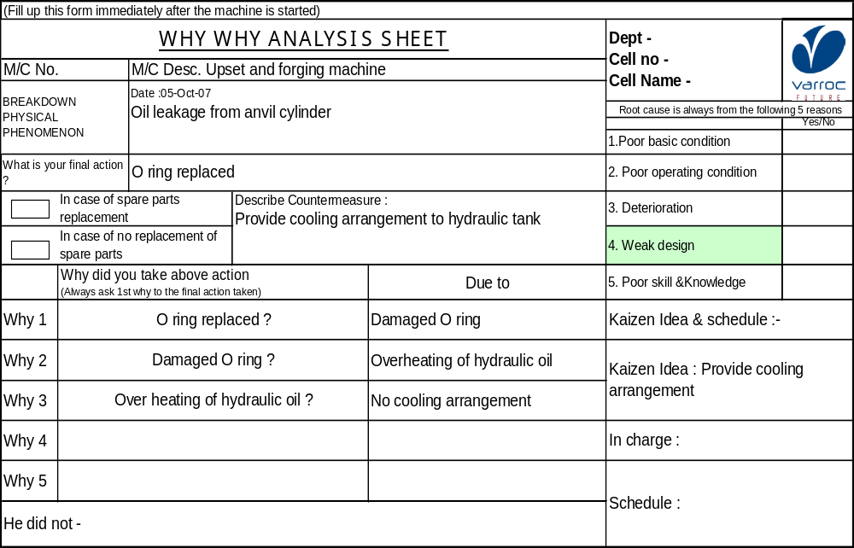
PM WHY WHY ANALYSIS SHEET
Weak Design

Slide 33
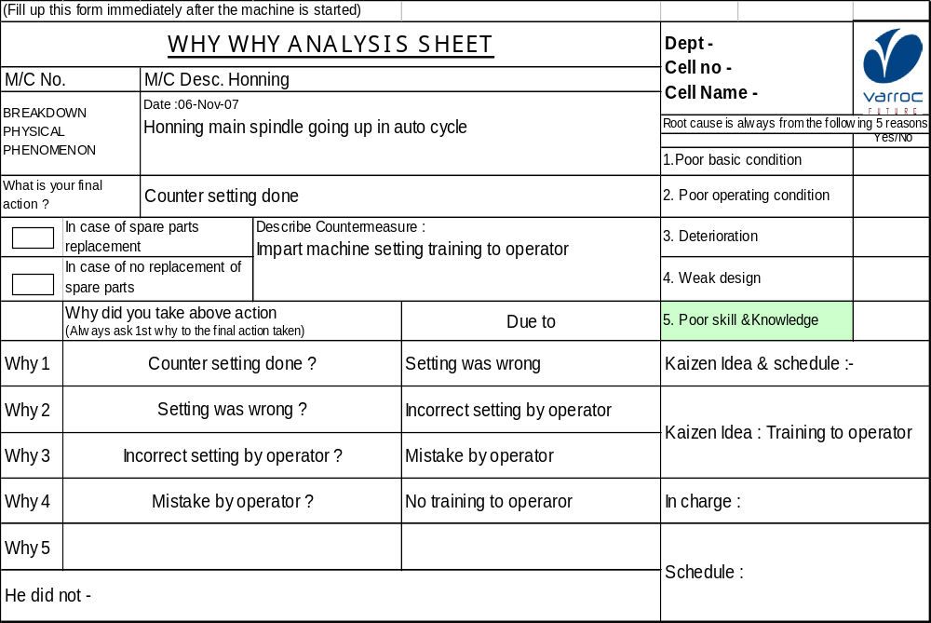
PM
PM WHY WHY ANALYSIS SHEET
Poor skill & knowledge

Slide 34
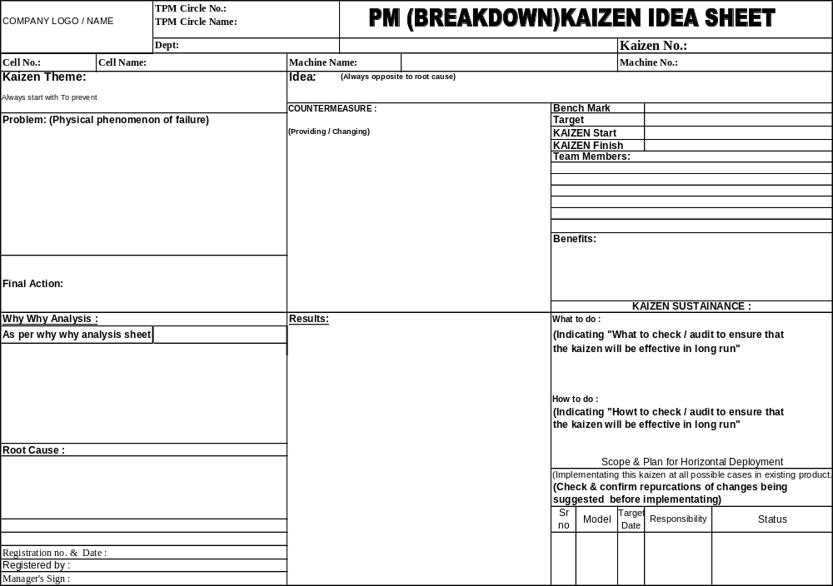
PM (BREAKDOWN KAIZEN IDEA SHEET

Slide 35
Types of Planned Maintenance
Planned Maintenance
Preventive Maintenance
Breakdown Maintenance
Corrective Maintenance
Time Based Maintenance
Condition Based Maintenance
TBM
CBM

Slide 36
TBM ( TIME BASED MAINTENANCE)

Slide 37
TBM ( TIME BASED MAINTENANCE)
It is also called a Periodic Maintenance coming under the Preventive Maintenance.
The period of repair is chosen based on the parameter Production volume, pieces, or number of operating days.
Advantages :
It does not take manpower or time for inspection.
Disadvantages :
Repair cost are high because of over- maintenance.

Slide 38
TBM ( TIME BASED MAINTENANCE)
Time Based Maintenance activities are selected on the basis of Equipment Supplier’s recommendation and past performance of the Equipment.
Periodic Inspection, cleaning, servicing, part replacement, lubrication and oil replacement activities are carried out at predetermined intervals to restore the Equipment deterioration.
Time Based Maintenance and Lubrication activities and Quality Plan
Identification of TBM activities and intervals
Time Based Maintenance and Lubrication yearly activity schedule
Preparation of TBM Calendar
Time Based Maintenance and Lubrication work order.
Perform TBM activities
Review of TBM activities
Record of TBM
Condition Based Maintenance
JH Activities
Equipment failure countermeasure

Slide 39
TBM ( TIME BASED MAINTENANCE)
Periodic Maintenance ( TBM )
Time
Rectify weaknesses by improvement ( Corrective Maintenance)
Natural deterioration
Parts are replaced through still useful
Parts are replaced although wear was severe
Accelerated deterioration
Parts are not replaced before failure
Limit Line
Replace parts on schedule
Periodic Maintenance
Tendency to replace at greater frequency is expensive accelerated wear may result in failures

Slide 40
CBM ( CONDITION BASED MAINTENANCE)

Slide 41
CBM ( CONDITION BASED MAINTENANCE)
Monitor and analyze the deterioration data regularly and constantly.
Repair if the deterioration parameter reaches a predetermined critical value.
Advantages :
CBM can prevent over – maintenance, which is a problem with TBM.
Disadvantages :
Equipment diagnosis and monitoring system can be costly.

Slide 42
CBM ( CONDITION BASED MAINTENANCE)
Quality Plan of CBM measuring point having -
1. Standard vibration limit
2. Standard bearing temp. limit
3. Frequency of measuring point
4. Input from failure assessment
CBM Process
Report 1
CBM measuring point monthly schedule
Report 2
Weekly reschedule of
1.Backlog points
2.Points where corrective action taken
Condition Checking
Value with limit
Computerized analysis
Report 3
Value beyond limit
Overall Vibration
Report 4
Fault predicted
Equipment status. Feedback from Dept.
Frequency spectra
Condition trend chart with action required
Report 5
Weekly statement of abnormal condition and Corrective Maintenance
M/C condition trend data fed in computer
Report 6

Slide 43
CBM ( CONDITION BASED MAINTENANCE)
Periodic Maintenance ( CBM )
Time
Rectify weaknesses by improvement ( Corrective Maintenance)
Diagnosis
Natural deterioration
Standard Value
Accelerated deterioration
Prediction
Replace parts when they reach standard wear
Limit Line
If Diagnosis is reliable, standard value can be set near the limit line.
This is the most economical method.
Predictive Maintenance highly depends on level of diagnostic techniques.
Wrong diagnosis is dangerous.

Slide 44
Step-4 – Build an Information Management System
Feed the equipment history i.e. the breakdown maintenance report, failure analysis report, preventive maintenance report etc.
Using equipment data and history, arrive at monthly / yearly preventive maintenance plan
Spares inventory control

Slide 45
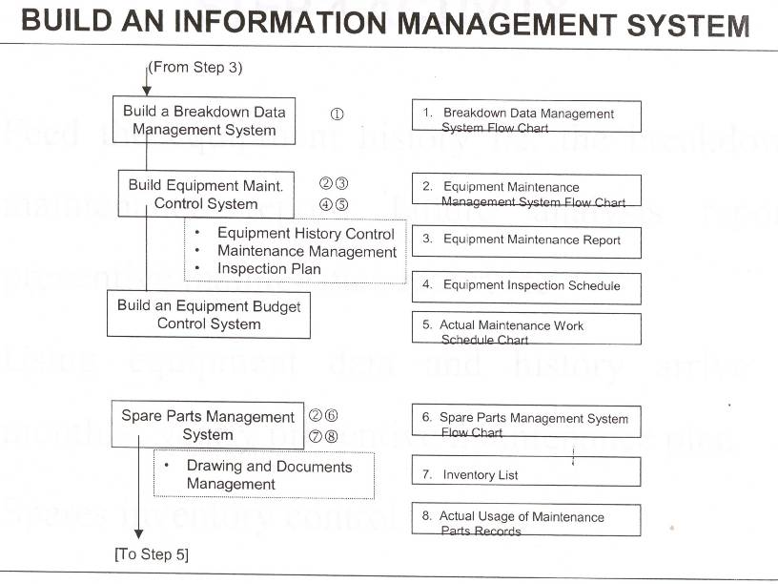
Step-4 – Build an Information Management System

Slide 46
Step-5 – Build an Periodic Maintenance System
Prepare time based work system flow to carry out the activities. The efficiency of time based maintenance could felt in reality of equipment and cost.
The Kaizens related to life span improvement of parts, easy maintainability of parts are to be arrived at.
Revisit optimal condition check sheet and correct wherever necessary based on experience.

Slide 47
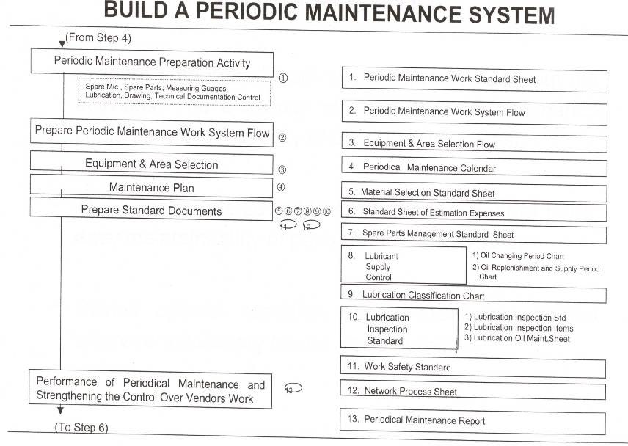
Step-5 – Build an Periodic Maintenance System

Slide 48
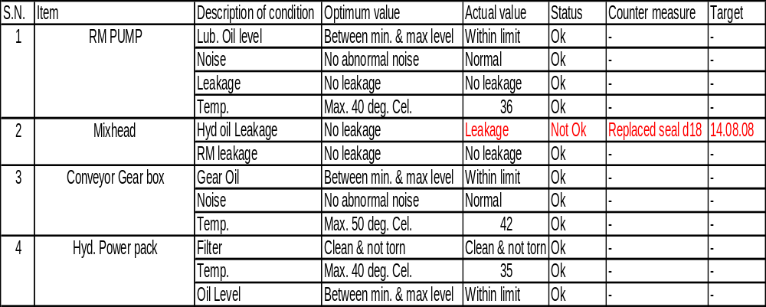
Optimal Condition Check Sheet

Slide 49
Step-6 – Build an Predictive Maintenance System
Introduce Equipment Diagnostic Technology. Train Maintenance personnel in handling Diagnostic Instruments / Devices
The following are the various diagnosis method
Temperature Method
Vibration Method
Oil Analysis Method
Liquid Penetrant Method
Dimension Measuring Method
Electric Resistance Method
Prepare Diagnostic Maintenance Work system flow.
Select area and implement Equipment Diagnostic System in to practice.
Develop Equipment Diagnosis skill and change TBM parts into CBM parts. Finally consolidate CBM.

Slide 50
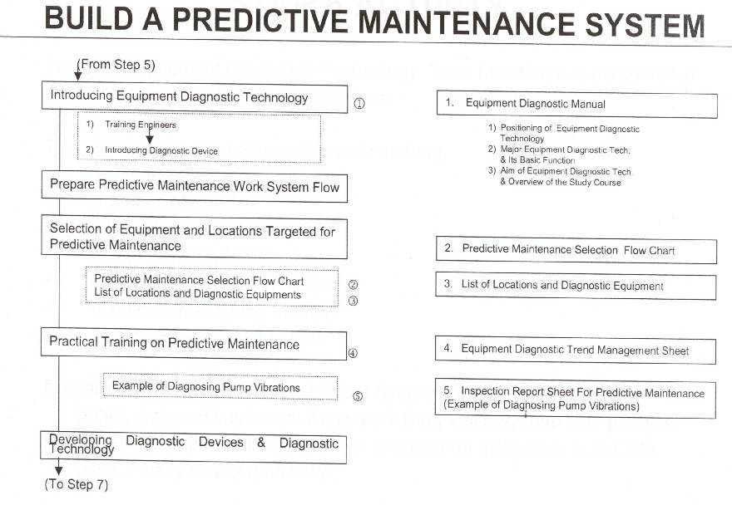
Step-6 – Build an Predictive Maintenance System

Slide 51
Step-7 – Evaluate the Planned Maintenance System
Compare the current results on breakdown rate, MTTR, MTBF, Preventive Maintenance rate, Maintenance cost, etc with the target.
After comparison, revisit the total system and strengthen the weak point.

Slide 52
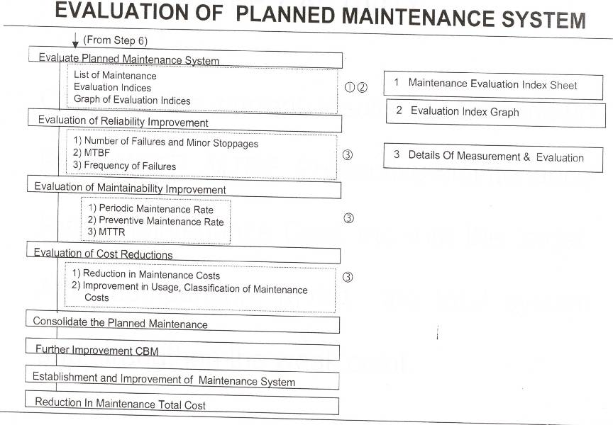
Step-7 – Evaluate the Planned Maintenance System

Slide 53
MTBF and MTTR
DEFINITION
MTBF - Mean Time Between Failure
MTTR - Mean Time To Repair
A
a
B
b
C
c
D
Run
MTBF = A+B+C+D / 4
MTTR = a+b+c / 3
Repaired

Slide 54

Spare Parts Control

Slide 55
Concept of Spare Parts Control
What Items?
● Decide what items to be stocked.
What Quality?
● Decide maximum stock levels
Purchasing- Order point, order quantity
Storage- “ Visual Control’
What control method?

Slide 56
Example of Classification of Materials Used for Maintenance
Die,roll,jigs
Cutting tip, tool
Items used for Production
Others
Analytical instrument, filler etc
Non-stocked items
Change gear, reduction gear, pump, fan, motor etc
Spare equipment
Equipment parts
Pulley gear, impellers etc.
Guide roller, special Oven, heating element etc.
Items used for maintenance
Commercially available
common parts
Bolt, nut, belt, chain, sealing component,
pneumatic& hydraulic devices & component,
Piping component, wiring component, electrical
parts etc
Commercially available
common materials
Steel pipe, electrical wire, oven materials,
welding materials
Fatty oils, paints etc
Stocked Items
Tools
Spanner, file, cutting tip, jig etc
Consumables
Waste cloth, paper, washing oil etc

Slide 57
How to Determine What Items Should be Stocked
Check Items
• Check past usage records • Check if their will be future equipment material changes in equipment or parts • Check if there are unexpected failures • Check level of repair & maintenance techniques. • Others
Possible to schedule consumption
•Possible to forecast replacement •Period by monitoring wear & tear •Others
Impossible to schedule consumption
•Impossible to schedule consumption due to sporadic failure or other reasons
Annual Usages
Unit price is
Cheap
Unit price is
expensive
Less than
X times
More than
X times
Consider
Stock-out
loss
Stock out loss
is bigger
Stocked
Items
Non-Stocked
Items
Non-stock
Items
Stock out loss
is smaller

Slide 58
Spare parts Replenishment Method
Individual Order
Method
( Purchase separately on an as-needed basis)
Planned Purchase
Purchase on an as-needed basis
Stocked-Item
Method
Fixed Order
Quantity Method
(Fixed order quantity, variable order period )
Order point method ( basic from of replenishment )
Double-bin method
(Order point & order quantity are equal )
Packaging method (Simplification of office work )
Lump sum order method
( Lump sum order & storage in shop floor )
Fixed Order
Interval Method
( Check inventory level at fixed internal & order.
variable order quantity )
Fixed Inventory
Level Method
( Order only the quantity used. Fixed inventory level)

Slide 59
MP Activity
(Maintenance Prevention Activity)

Slide 60
MP stands for “Maintenance prevention.” MP activity refers to consideration
of maintenance information & new technologies during planning &
construction of new equipment, design of equipment with
high reliability, maintainability, economics, operability, safety etc., &
reduction of maintenance cost & losses incurred by deterioration.
MP Activity Flow
Plan
Design
Check on design
Installation.
Trial run
Initial
flow
Fabrication & joint evaluation
MP design
Initial
Flow control
MP activity

Slide 61
Mp information elements
Basic Category | Definition | Elements
Reliability | Capability of avoiding functional decline & stoppage | Low frequency of breakdown occurrence Low frequency of minor stoppages occurrence | -Small no. of adjustments Machine cycle time stability Ease of static & dynamic accuracy measurements
Maintainability | Capability of performing Deterioration Measurement easily, when Deteriorated, capability of Being easily restored | Ease of failed part detection Ease of part replacement speed of functional recovery confirmation | Ease of finding deteriorated parts Ease of oil supply & replacement Ease of over haul
Jishu Hozen Capability | Capability of quickly receiving maintenance such as Cleaning, oiling, inspection etc Done by the operation department | Ease of receiving, cleaning, inspection, oiling, Ease of chip collection Level of containment of problem sources & scattering koizumi ? What does it mean???? | Ease of oiling check up Ease of quality maintenance ( ease of yielding precision measurements)

Slide 62
Basic Category | Definition | Elements
Operability | Capability of quickly & reliably perform correct operation or changeover | - Ease of performing changeover & adjustment Ease of replacing & adjusting cutting tools & grindstone | - Ease of operating button ( height, location, quantity, shape, colour etc) - Ease of transportation & installation of equipment.
Resource saving Capability | Capability to perform efficient use of necessary Resources such as energy, Cutting tools, grind stone, Fatty oil, etc. | - Ease of performing Changeover & adjustment Ease of replacing & adjusting cutting tools & grind stone | Level of resource recycling Energy saving design implemented ?
Safety Capability | Capability to prevent direct & indirect harm on human body | Low frequency of task such as treatment of breakdown, minor stoppages, quality defects Low exposure of rotating parts & drive parts | Few protruding or hooking parts. - Easy to dodge safety hazard

Slide 63
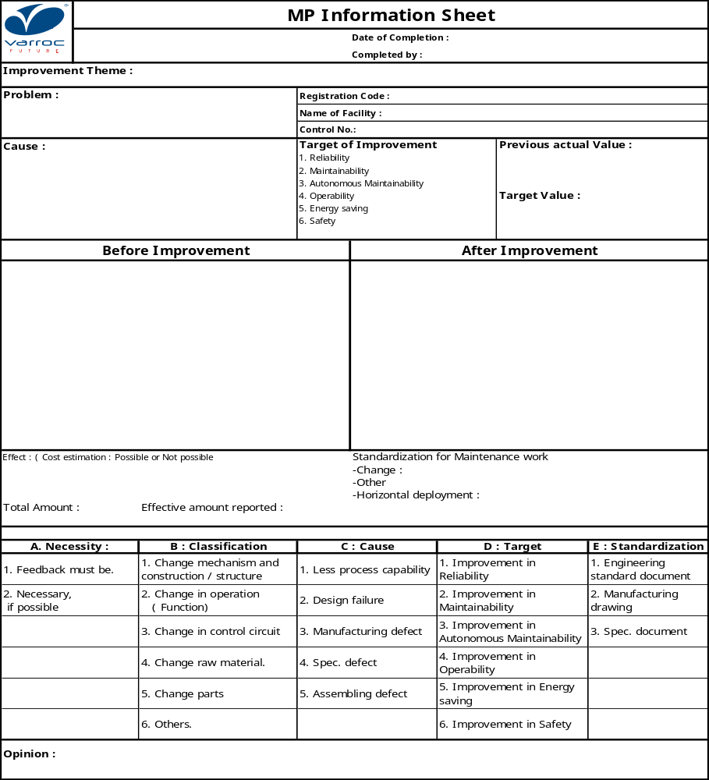
MP (Maintenance Prevention) sheet

Slide 64

Collection & Application of MP Information

Slide 65
Collection & Application of MP information
MP Activity
MP Design
Initial control activity
MP Design standard
MP checklist
MP Information
Jishu
Hozen
information
Maintenance
record
Corrective
Maintenance
record
External
information
of technology
Comments during
Joint confirmation
session
Information
from
Manufacturing
site
One point
lesson
Legwork
information

Slide 66
THANK YOU

